Slide 1
Study plan
SEMESTER | CONTENT
1 (3) | 28745 Industrial cell-based reaction engineering. 5 ECTS. 28761 Mathematical modeling for industrial applications. 5 ECTS. 28720 Down Stream Processing. 7.5 ECTS.
2 (4) | 42500 Innovation in Engineering. 5 ECTS. 28737 Project related to Down Stream Processing – including Innovation aspects. 10 ECTS.
3 (1) | 28730 Transport Phenomena (with Fluid Dynamics). 5 ECTS. 28751 Instrumentation, Digitalization and Control. 5 ECTS. 28750 Process design, Retrofit, Risk assessment. 7.5 ECTS.
4 (2) | 12100 Quantitative Sustainability. 5 ECTS. 28747 Project related to Reaction Engineering – including Sustainability aspects. 10 ECTS.
5 | 28725 Advanced Unit Operations Lab – including digitalization. 5 ECTS. 28757 Good Manufacturing Practice (GMP). 5 ECTS. Course to be decided. 5 ECTS.
6 | 28777 Project related to Kalundborg Symbiosis (including presentations of all the involved companies). 10 ECTS.
7 | MSc project related to company. Graduation. 30 ECTS
8 | MSc project related to company. Graduation. 30 ECTS

Slide 2
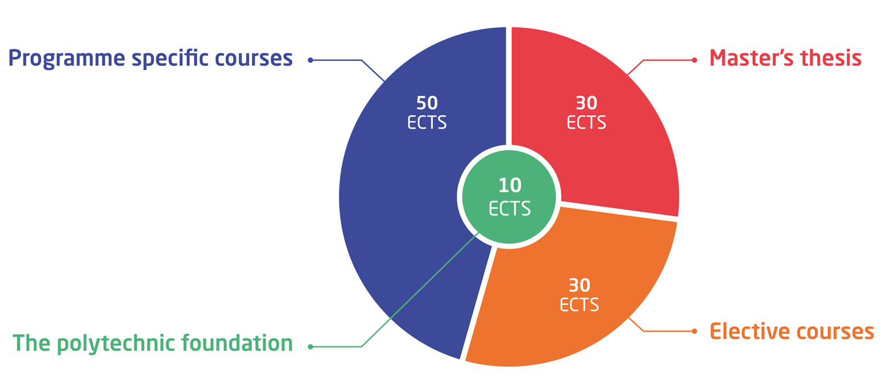
Yearly schedule for courses
Week no. | 35 | 36 | 37 | 38 | 39 | 40 | 41 | 42 | 43 | 44 | 45 | 46 | 47 | 48 | 49 | 50 | 51 | 52 | 1 | 2 | 3 | 4 | 5 | 6 | 7 | 8 | 9 | 10 | 11 | 12 | 13 | 14 | 15 | 16 | 17 | 18 | 19 | 20 | 21 | 22 | 23 | 24 | 25 | 26 | 27 | 28 | 29 | 30 | 31 | 32 | 33 | 34
Y1 |  |  |  |  | Course |  |  |  | Course |  |  | Course |  |  |  |  |  |  | Course |  |  |  |  | Project
Y2 |  |  |  |  | Course |  |  |  | Course |  |  | Course |  |  |  |  |  |  |  |  |  |  |  | Project
 |  |  |  |  |  |  |  |  |  |  |  |  |  |  |  |  |  |  |  |  |  |  | Course, Tue 18-20 or Fri 13-15
Y3 |  |  |  |  | Course |  |  |  | Course |  |  | Course |  |  |  |  |  |  |  |  |  |  |  | Project
Y4 | Thesis with full time load |  | X |  | X |  | X |  | X |  | X |  | X |  | X |  | X |  |  |  | X |  | X |  | X |  | X |  | X |  | X |  | X |  | X
 | Thesis with half time load

